Slide 1
The ESA-UCB Clinical Scholarship
A proud partnership between the Epilepsy Society of Australia, and UCB Australia

Slide 2
The ESA-UCB Clinical Scholarship
The ESA-UCB Clinical Scholarship
A proud partnership between the Epilepsy Society of Australia, and UCB Australia
Awarded since 2004, the scholarship is an important commitment from UCB to support the development of future leaders in epilepsy in Australia.
Former recipients of the scholarship include …
The scholarship is awarded annually to enable a young physician to undertake specialised training in the field of epilepsy.
A proud partnership between the Epilepsy Society of Australia, and UCB Australia

Slide 3
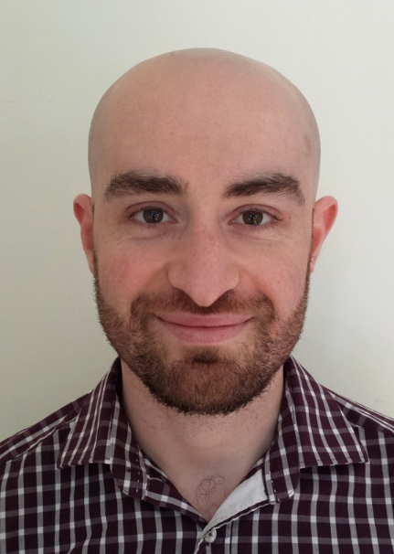
“
Dr Andrew Neal, Consultant Neurologist, Royal Melbourne Hospital, St Vincent’s Hospital Melbourne; Miriam Greenfield Fellow, RACP, University of Melbourne
2016
ESA-UCB Clinical Scholarship Recipient
My major research interest to date has concerned brain tumour related epilepsy. I am currently in the final stages of a clinical epilepsy PhD exploring molecular factors associated with tumour-associated epilepsy.
“

Slide 4
“
Dr Andrew Neal, Consultant Neurologist, Royal Melbourne Hospital, St Vincent’s Hospital Melbourne; Miriam Greenfield Fellow, RACP, University of Melbourne
2016
ESA-UCB Clinical Scholarship Recipient
In addition, I am one of the principal investigators in a recently commenced multicentre randomised controlled trial examining targeted treatments for glioma- associated seizures.
“

Slide 5
Dr Andrew Neal, Consultant Neurologist, Royal Melbourne Hospital, St Vincent’s Hospital Melbourne; Miriam Greenfield Fellow, RACP, University of Melbourne
2016
ESA-UCB Clinical Scholarship Recipient
“
My other area of interest is invasive EEG and in 2018 I’ll be commencing a one-year stereo-EEG fellowship in Lyon, France.
“

Slide 6
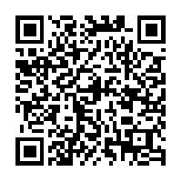
How to apply for the ESA-UCB Clinical Scholarship
Visit the Epilepsy Society of Australia website for information on how to apply
www.epilepsy-society.org.au

Slide 7
The ESA-UCB Clinical Scholarship
A proud partnership between the Epilepsy Society of Australia, and UCB Australia

Slide 8
The ESA-UCB Clinical Scholarship
The ESA-UCB Clinical Scholarship
A proud partnership between the Epilepsy Society of Australia, and UCB Australia
Awarded since 2004, the scholarship is an important commitment from UCB to support the development of future leaders in epilepsy in Australia.
Former recipients of the scholarship include …
The scholarship is awarded annually to enable a young physician to undertake specialised training in the field of epilepsy.
A proud partnership between the Epilepsy Society of Australia, and UCB Australia

Slide 9
“
Dr Emma Whitham, Staff Specialist Neurologist, Flinders Medical Centre, Adelaide
2004
ESA-UCB Clinical Scholarship Recipient
I believe I was the first recipient of the ESA-UCB Clinical Scholarship in 2004, and have been very grateful to the ESA and UCB for the funding I received.
This sponsorship went a good way to supporting me through the project I was involved with at the time and was instrumental in bridging the gap until we subsequently gained an NHMRC grant.
“

Slide 10
“
Dr Emma Whitham, Staff Specialist Neurologist, Flinders Medical Centre, Adelaide
2004
ESA-UCB Clinical Scholarship Recipient
Through our study, ‘High Frequency EEG in Epilepsy and Other Neurological Conditions’, it became apparent that contaminating muscle was a major problem for detailed analysis of fast activity of the brain.
We undertook some experiments in awake, paralysed subjects to enable us to obtain the only muscle-free scalp EEG dataset.
“

Slide 11
“
Dr Emma Whitham, Staff Specialist Neurologist, Flinders Medical Centre, Adelaide
2004
ESA-UCB Clinical Scholarship Recipient
This dataset continues to allow the group to scrutinise the EEG of the subset of epilepsies and other conditions, and the enduring attempt to generate algorithms to try and remove superfluous muscle contamination from scalp EEGs.
“

Slide 12
“
Dr Emma Whitham, Staff Specialist Neurologist, Flinders Medical Centre, Adelaide
2004
ESA-UCB Clinical Scholarship Recipient
I continued my clinical training working with the epilepsy group at the Royal Brisbane and Women’s Hospital, and have since returned to Adelaide.
I am currently a Staff Specialist Neurologist at Flinders Medical Centre in Adelaide with a continuing subspecialist interest in epilepsy.
“

Slide 13
How to apply for the ESA-UCB Clinical Scholarship
Visit the Epilepsy Society of Australia website for information on how to apply
www.epilepsy-society.org.au

Slide 14
The ESA-UCB Clinical Scholarship
A proud partnership between the Epilepsy Society of Australia, and UCB Australia

Slide 15
The ESA-UCB Clinical Scholarship
The ESA-UCB Clinical Scholarship
A proud partnership between the Epilepsy Society of Australia, and UCB Australia
Awarded since 2004, the scholarship is an important commitment from UCB to support the development of future leaders in epilepsy in Australia.
Former recipients of the scholarship include …
The scholarship is awarded annually to enable a young physician to undertake specialised training in the field of epilepsy.
A proud partnership between the Epilepsy Society of Australia, and UCB Australia

Slide 16
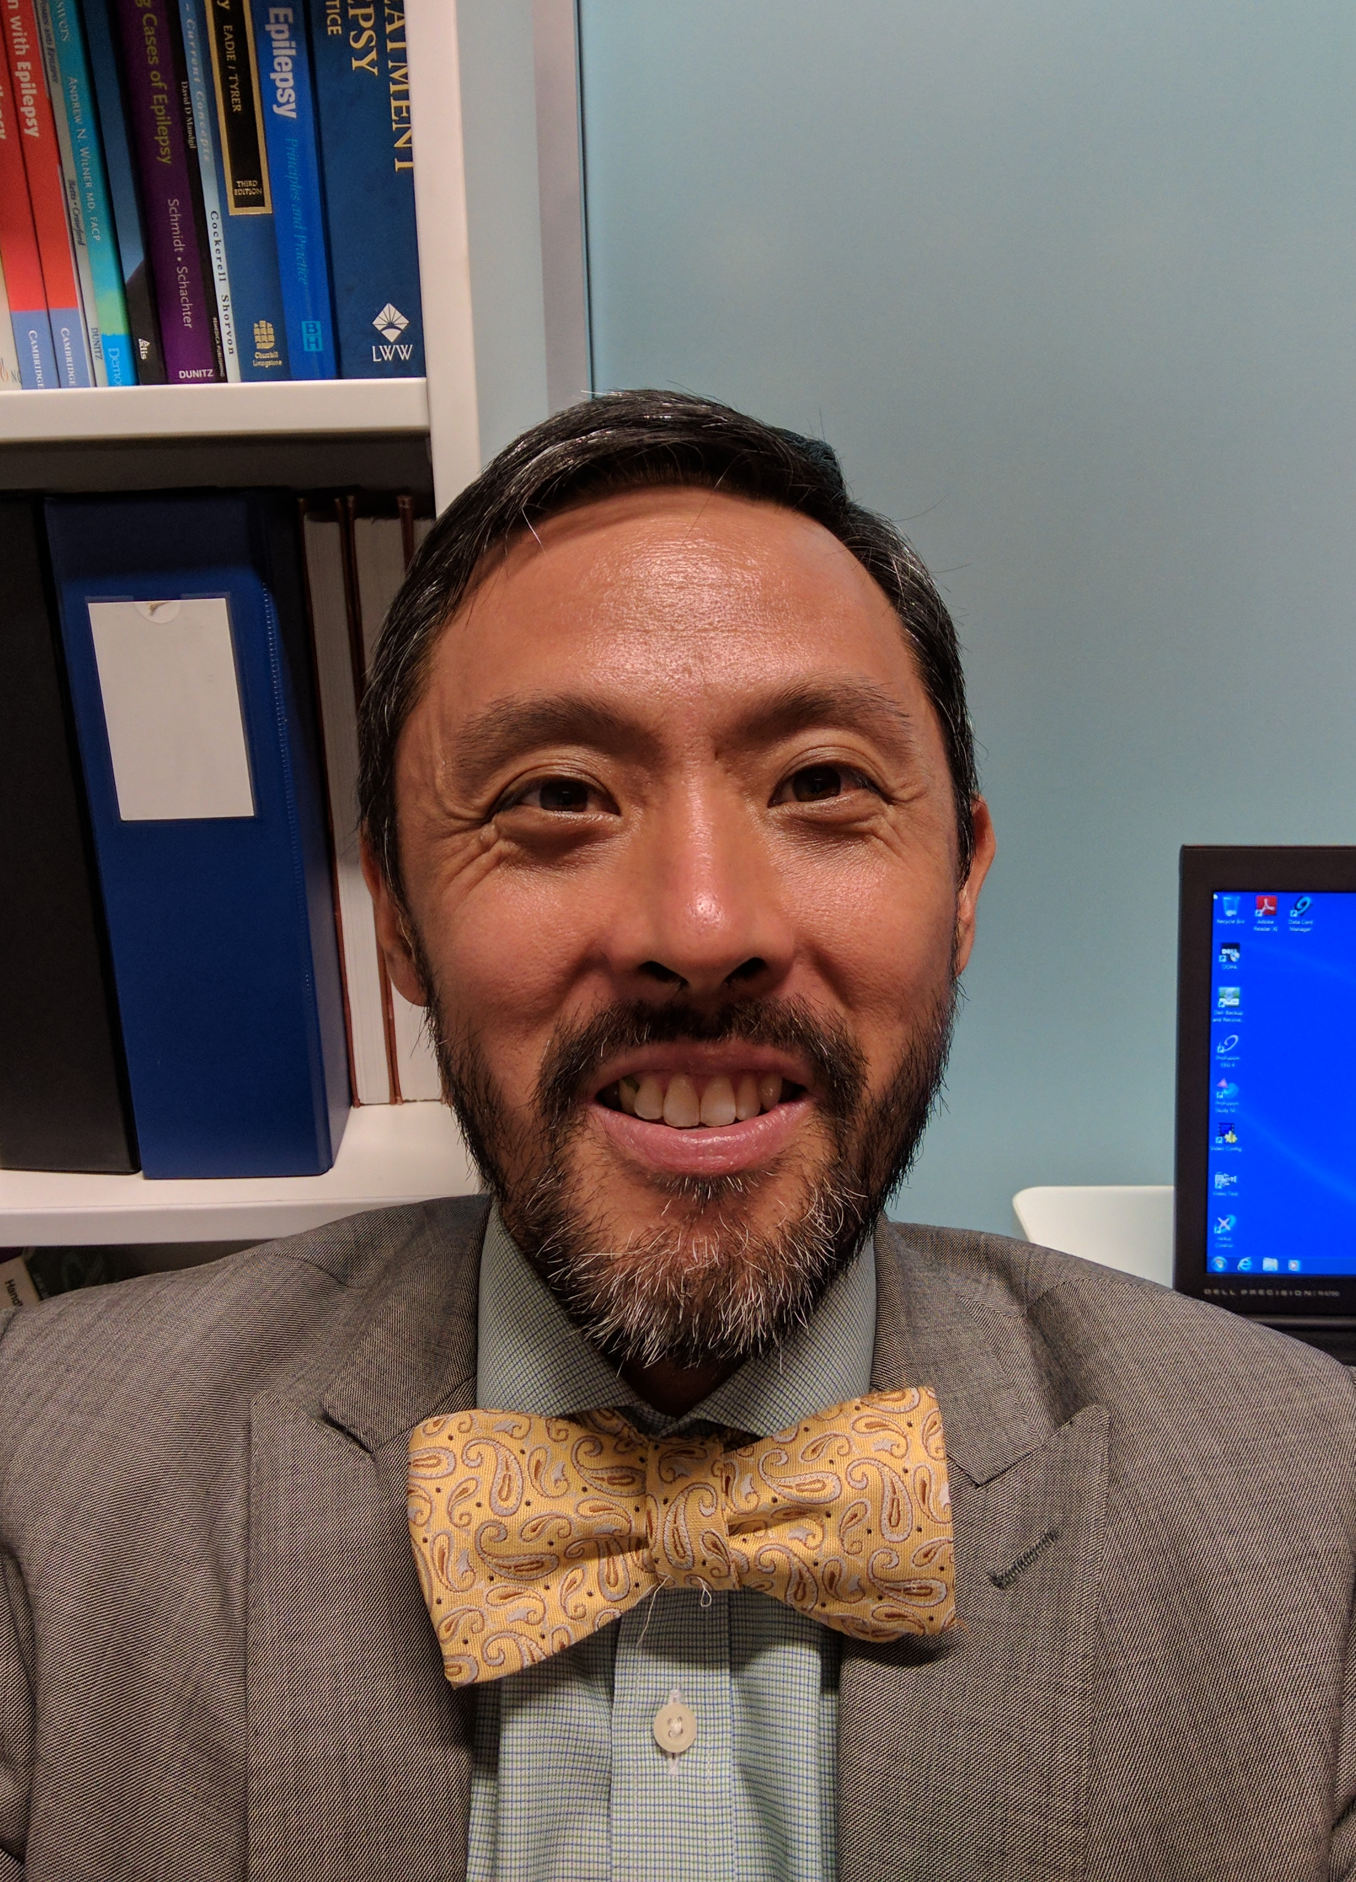
“
Dr Kee Meng Tan, Medical Director of Neurology at Gold Coast Health, Gold Coast University Hospital and Robina Hospital; Previously at The Royal Melbourne Hospital Comprehensive Epilepsy Program 2010‒16
2009
ESA-UCB Clinical Scholarship Recipient
My research interests include autonomic dysfunction and sudden death in epilepsy.
I provide advice to the TGA on safety, quality and efficacy of medications, especially those used in neurological conditions.
“

Slide 17
“
Dr Kee Meng Tan, Medical Director of Neurology at Gold Coast Health, Gold Coast University Hospital and Robina Hospital; Previously at The Royal Melbourne Hospital Comprehensive Epilepsy Program 2010‒16
2009
ESA-UCB Clinical Scholarship Recipient
I have close involvement with several educational initiatives within the RACP.
The experience acquired while supported by the ESA-UCB Scholarship prepared me for the challenge of running a clinical neurophysiology service and establishing an epilepsy surgery program.
“

Slide 18
How to apply for the ESA-UCB Clinical Scholarship
Visit the Epilepsy Society of Australia website for information on how to apply
www.epilepsy-society.org.au

Slide 19
The ESA-UCB Clinical Scholarship
A proud partnership between the Epilepsy Society of Australia, and UCB Australia

Slide 20
The ESA-UCB Clinical Scholarship
The ESA-UCB Clinical Scholarship
A proud partnership between the Epilepsy Society of Australia, and UCB Australia
Awarded since 2004, the scholarship is an important commitment from UCB to support the development of future leaders in epilepsy in Australia.
Former recipients of the scholarship include …
The scholarship is awarded annually to enable a young physician to undertake specialised training in the field of epilepsy.
A proud partnership between the Epilepsy Society of Australia, and UCB Australia

Slide 21
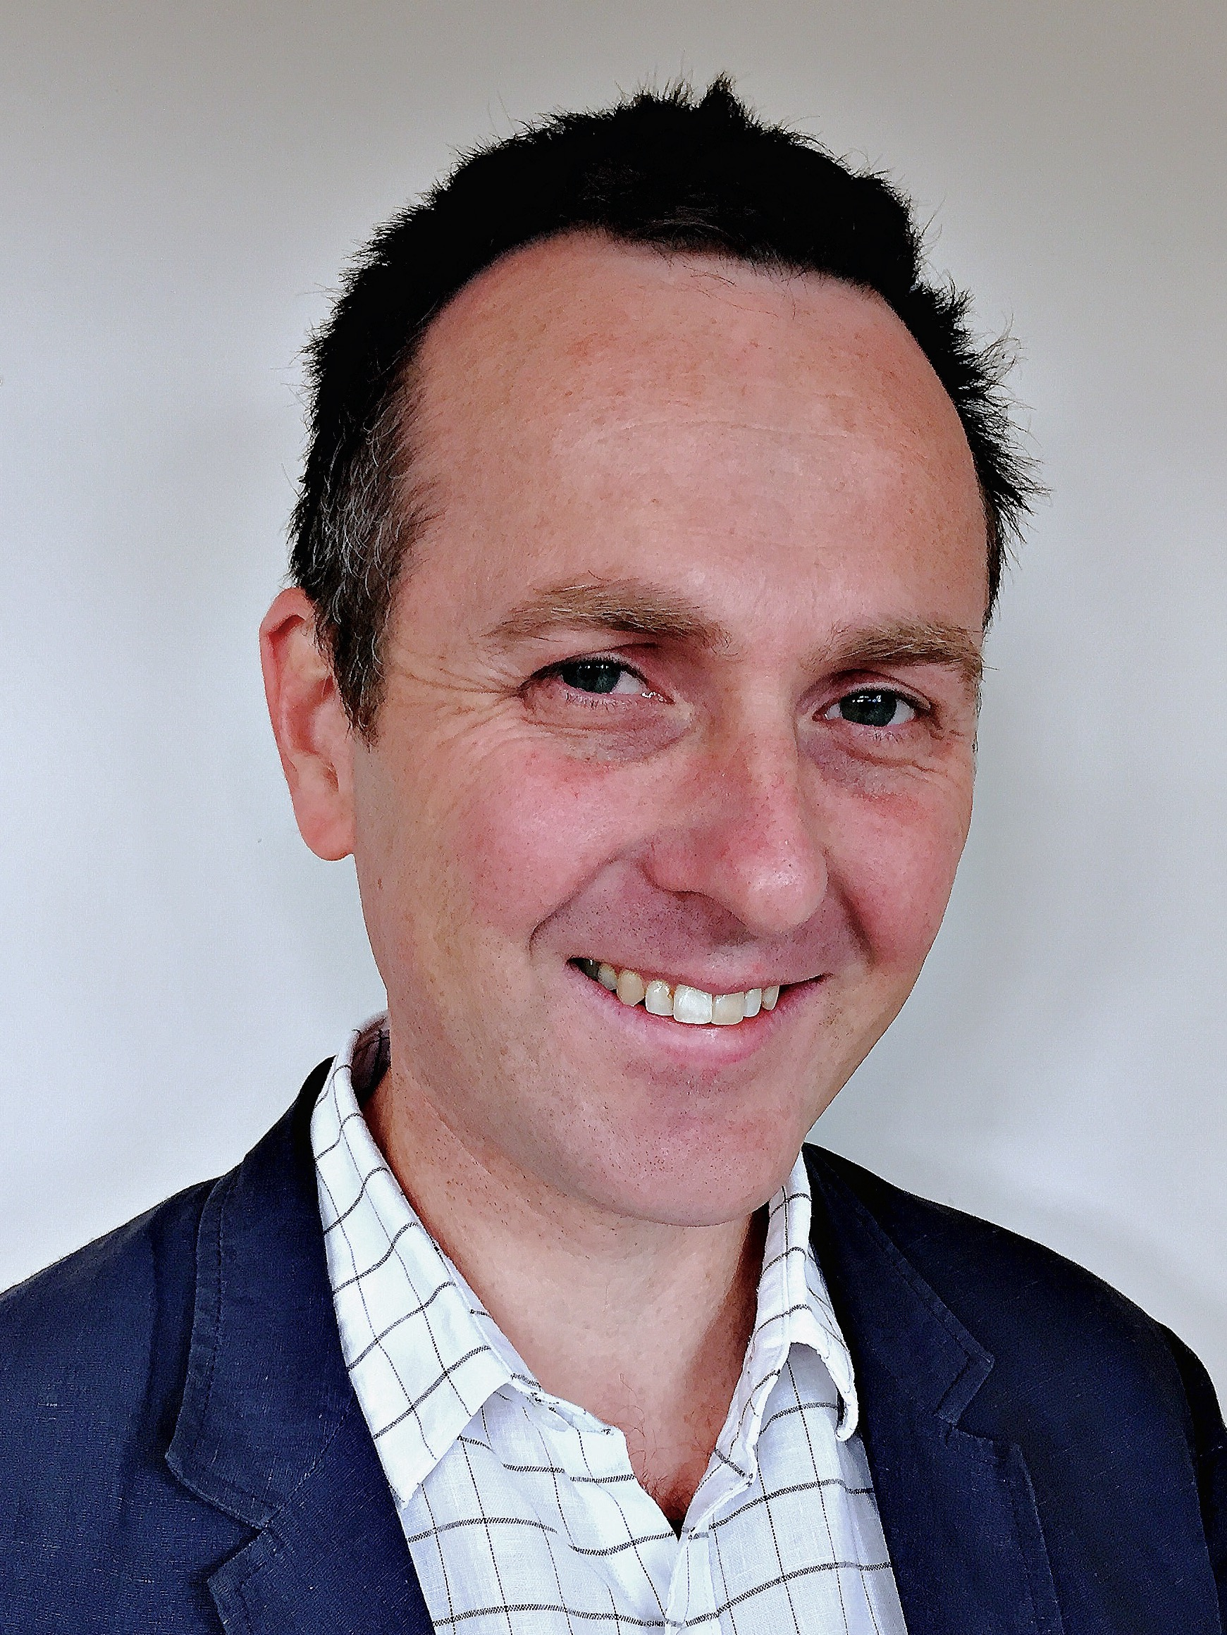
“
Dr Tyson Ware, Staff Specialist Paediatric Neurologist, Royal Hobart Hospital
2010
ESA-UCB Clinical Scholarship Recipient
“
I am the sole practising paediatric neurologist in Tasmania.
I have published papers and presentations in regard to infantile spasms, PNPO deficiency, neonatal seizures and childhood epilepsy in the undeveloped setting, and myoclonic epilepsy.
“

Slide 22
“
Dr Tyson Ware, Staff Specialist Paediatric Neurologist, Royal Hobart Hospital
2010
ESA-UCB Clinical Scholarship Recipient
“
My current major research project is the Tasmanian Infantile Epileptic Encephalopathy Study: Epidemiology and Etiology of IEE in Tasmania.
“

Slide 23
How to apply for the ESA-UCB Clinical Scholarship
Visit the Epilepsy Society of Australia website for information on how to apply
www.epilepsy-society.org.au

Slide 24
The ESA-UCB Clinical Scholarship
A proud partnership between the Epilepsy Society of Australia, and UCB Australia

Slide 25
The ESA-UCB Clinical Scholarship
The ESA-UCB Clinical Scholarship
A proud partnership between the Epilepsy Society of Australia, and UCB Australia
Awarded since 2004, the scholarship is an important commitment from UCB to support the development of future leaders in epilepsy in Australia.
Former recipients of the scholarship include …
The scholarship is awarded annually to enable a young physician to undertake specialised training in the field of epilepsy.
A proud partnership between the Epilepsy Society of Australia, and UCB Australia

Slide 26
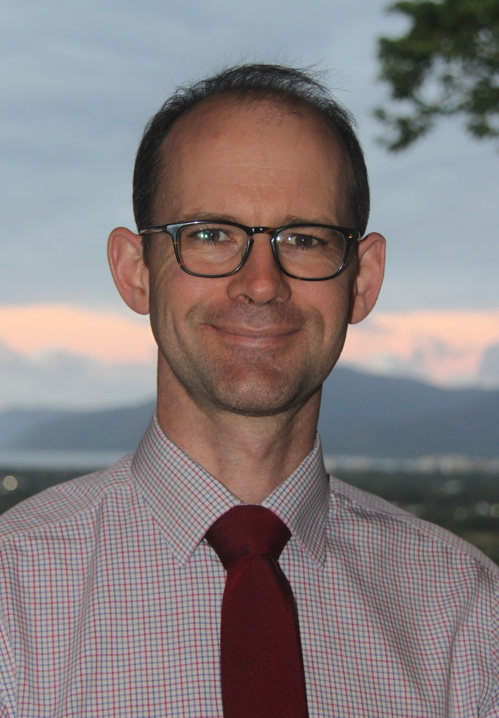
Dr Ian Wilson, Neurology Consultant, Cairns Hospital
2014
ESA-UCB Clinical Scholarship Recipient
“
After completing my UCB scholarship year, I undertook a further fellowship at St Vincent’s Hospital Melbourne, working with the comprehensive epilepsy program.
“

Slide 27
Dr Ian Wilson, Neurology Consultant, Cairns Hospital
2014
ESA-UCB Clinical Scholarship Recipient
I relocated to Cairns in far North Queensland where I now work as one of three neurologists providing services to this geographically vast and diverse region.
I have established an epilepsy clinic at the Cairns Hospital and we provide a range of EEG services.
“
“

Slide 28
Dr Ian Wilson, Neurology Consultant, Cairns Hospital
2014
ESA-UCB Clinical Scholarship Recipient
“
I have continued engagement with the comprehensive epilepsy program at the Royal Brisbane Hospital, providing my expertise on patient management and facilitating referral of local patients to undertake advanced assessment and access epilepsy surgery.
“

Slide 29
How to apply for the ESA-UCB Clinical Scholarship
Visit the Epilepsy Society of Australia website for information on how to apply
www.epilepsy-society.org.au

Slide 30
The ESA-UCB Clinical Scholarship
A proud partnership between the Epilepsy Society of Australia, and UCB Australia

Slide 31
The ESA-UCB Clinical Scholarship
The ESA-UCB Clinical Scholarship
A proud partnership between the Epilepsy Society of Australia, and UCB Australia
Awarded since 2004, the scholarship is an important commitment from UCB to support the development of future leaders in epilepsy in Australia.
Former recipients of the scholarship include …
The scholarship is awarded annually to enable a young physician to undertake specialised training in the field of epilepsy.
A proud partnership between the Epilepsy Society of Australia, and UCB Australia

Slide 32
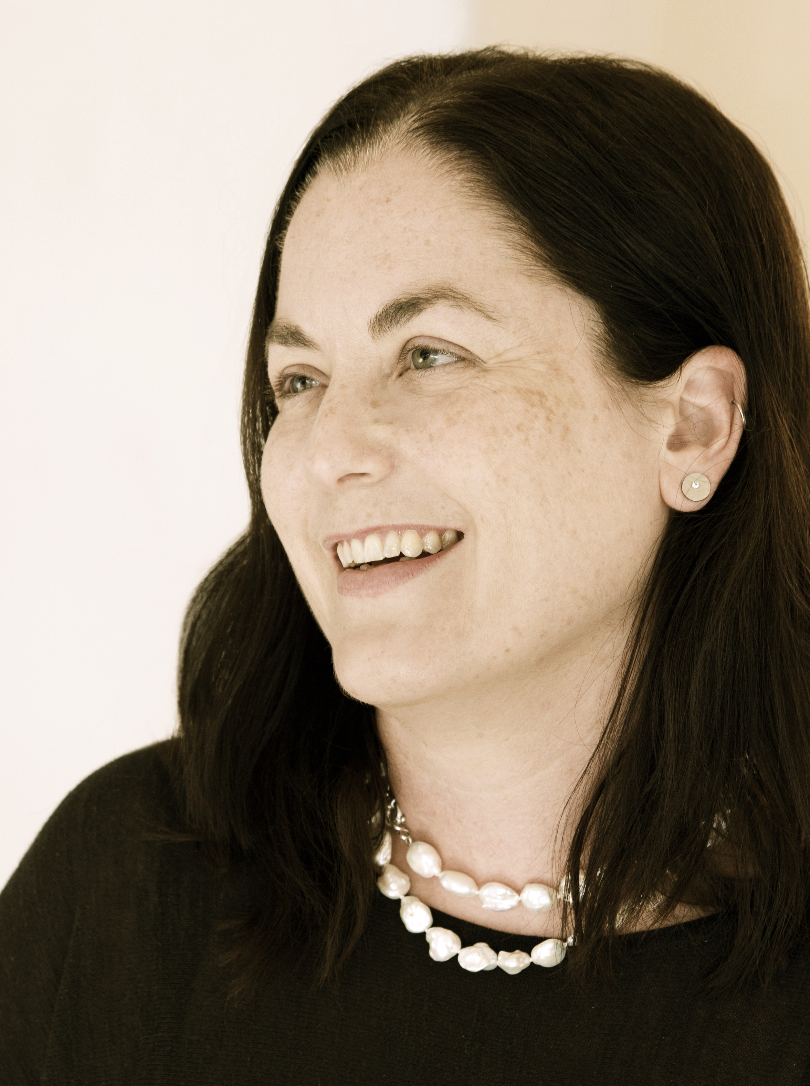
“
Dr Sophie Adams, Clinical Director, headspace Sunshine, headspace Craigieburn, headspace Glenroy, headspace Werribee, operated by Orygen, The National Centre for Excellence in Youth Mental Health
2005
ESA-UCB Clinical Scholarship Recipient
I have also dedicated over a decade of my life to the study of the neuropsychiatry of focal epilepsy.
I have learnt a lot about why many prominent psychiatrists have only done one epilepsy paper, how we may have been wrong about the temporal lobe, and a little about the relationship between epilepsy and mental illness.
As well as my work as Clinical Director of four headspace centres, I am also a consultant psychiatrist with interests in clinical governance, youth mental health, the neuropsychiatry of epilepsy, ECT, somatoform disorders and abnormal illness behaviours.
“

Slide 33
“
Dr Sophie Adams, Clinical Director, headspace Sunshine, headspace Craigieburn, headspace Glenroy, headspace Werribee, operated by Orygen, The National Centre for Excellence in Youth Mental Health
As well as my work as Clinical Director of four headspace centres, I am also a consultant psychiatrist with interests in clinical governance, youth mental health, the neuropsychiatry of epilepsy, ECT, somatoform disorders and abnormal illness behaviours.
“

Slide 34
“
Dr Sophie Adams, Clinical Director, headspace Sunshine, headspace Craigieburn, headspace Glenroy, headspace Werribee, operated by Orygen, The National Centre for Excellence in Youth Mental Health
I have also dedicated over a decade of my life to the study of the neuropsychiatry of focal epilepsy.
I have learnt a lot about why many prominent psychiatrists have only done one epilepsy paper, how we may have been wrong about the temporal lobe, and a little about the relationship between epilepsy and mental illness.
“

Slide 35
How to apply for the ESA-UCB Clinical Scholarship
Visit the Epilepsy Society of Australia website for information on how to apply
www.epilepsy-society.org.au

Slide 36
The ESA-UCB Clinical Scholarship
A proud partnership between the Epilepsy Society of Australia, and UCB Australia

Slide 37
The ESA-UCB Clinical Scholarship
The ESA-UCB Clinical Scholarship
A proud partnership between the Epilepsy Society of Australia, and UCB Australia
Awarded since 2004, the scholarship is an important commitment from UCB to support the development of future leaders in epilepsy in Australia.
Former recipients of the scholarship include …
The scholarship is awarded annually to enable a young physician to undertake specialised training in the field of epilepsy.
A proud partnership between the Epilepsy Society of Australia, and UCB Australia

Slide 38
Dr Saul Mullen, Clinical Research Leader, Florey Institute of Neuroscience and Mental Health; Consultant Neurologist at Austin Health and Eastern Health
2006
ESA-UCB Clinical Scholarship Recipient
“
With the help of the ESA-UCB Clinical Scholarship, I completed my PhD in 2011.
Work through my PhD and post-doctorate showed the central role of both recurrent copy number variants and GLUT1-deficiency to the genetics of idiopathic generalised epilepsy.
“

Slide 39
“
Dr Saul Mullen, Clinical Research Leader, Florey Institute of Neuroscience and Mental Health; Consultant Neurologist at Austin Health and Eastern Health
2006
ESA-UCB Clinical Scholarship Recipient
My current work involves developing clinical trials for precision medicines in genetic epilepsies.
“

Slide 40
How to apply for the ESA-UCB Clinical Scholarship
Visit the Epilepsy Society of Australia website for information on how to apply
www.epilepsy-society.org.au

Slide 41
The ESA-UCB Clinical Scholarship
A proud partnership between the Epilepsy Society of Australia, and UCB Australia

Slide 42
The ESA-UCB Clinical Scholarship
The ESA-UCB Clinical Scholarship
A proud partnership between the Epilepsy Society of Australia, and UCB Australia
Awarded since 2004, the scholarship is an important commitment from UCB to support the development of future leaders in epilepsy in Australia.
Former recipients of the scholarship include …
The scholarship is awarded annually to enable a young physician to undertake specialised training in the field of epilepsy.
A proud partnership between the Epilepsy Society of Australia, and UCB Australia

Slide 43
“
Dr Linda Dalic, Epilepsy Fellow, Austin Health; PhD candidate, University of Melbourne/Austin Health
2017
ESA-UCB Clinical Scholarship Recipient
My current area of research assesses the role of neuromodulation in a type of drug-refractory epilepsy, Lennox-Gastaut syndrome (LGS).
This epilepsy syndrome usually begins in childhood, causing daily seizures and intellectual disability. Patients are frequently injured as a result of seizures and have many hospital presentations and admissions.
“

Slide 44
“
Dr Linda Dalic, Epilepsy Fellow, Austin Health; PhD candidate, University of Melbourne/Austin Health
2017
ESA-UCB Clinical Scholarship Recipient
We are currently trialling deep brain stimulation as a treatment for seizures in patients with LGS. This involves delivering electrical impulses to the thalamus.
Earlier pivotal studies have shown this to be beneficial in reducing seizures in focal epilepsy and there is some evidence that it can help with generalised epilepsy, including LGS.
“

Slide 45
How to apply for the ESA-UCB Clinical Scholarship
Visit the Epilepsy Society of Australia website for information on how to apply
www.epilepsy-society.org.au

Slide 46
The ESA-UCB Clinical Scholarship
A proud partnership between the Epilepsy Society of Australia, and UCB Australia

Slide 47
The ESA-UCB Clinical Scholarship
The ESA-UCB Clinical Scholarship
A proud partnership between the Epilepsy Society of Australia, and UCB Australia
Awarded since 2004, the scholarship is an important commitment from UCB to support the development of future leaders in epilepsy in Australia.
Former recipients of the scholarship include …
The scholarship is awarded annually to enable a young physician to undertake specialised training in the field of epilepsy.
A proud partnership between the Epilepsy Society of Australia, and UCB Australia

Slide 48
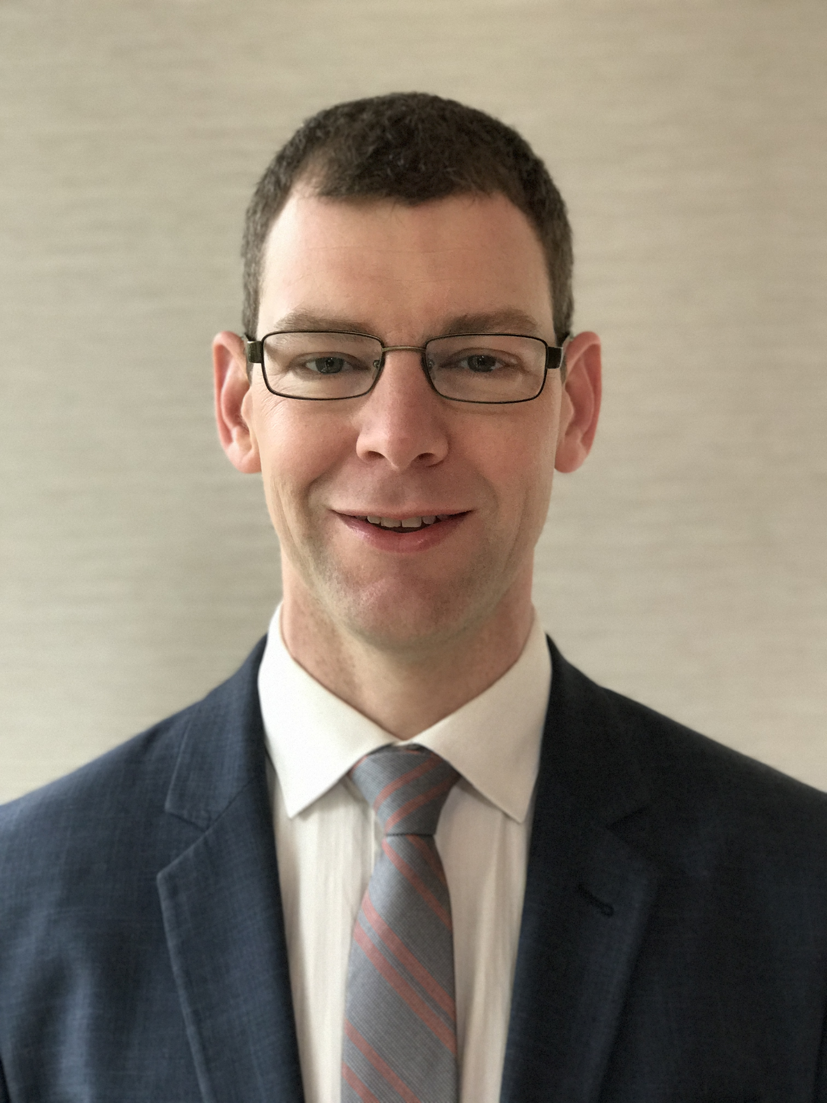
“
Dr David Vaughan, Neurologist at Austin Health; Research Officer in the Epilepsy Imaging Division, Florey Institute of Neuroscience and Mental Health
2012
ESA-UCB Clinical Scholarship Recipient
My research is in the use of advanced MRI methods to better define the brain regions that are affected in people with epilepsy.
In temporal lobe epilepsy, I have used diffusion imaging and functional imaging to identify the different brain networks that are involved in people with hippocampal sclerosis versus people without.
“

Slide 49
“
Dr David Vaughan, Neurologist at Austin Health; Research Officer in the Epilepsy Imaging Division, Florey Institute of Neuroscience and Mental Health
2012
ESA-UCB Clinical Scholarship Recipient
I have a particular interest in the piriform cortex, a key brain region for processing the sense of smell, and its involvement in epileptic activity.
My clinical work at the Austin Hospital has been in the epilepsy and first-seizure clinics and as part of the pre-surgical Comprehensive Epilepsy Program.
“

Slide 50
How to apply for the ESA-UCB Clinical Scholarship
Visit the Epilepsy Society of Australia website for information on how to apply
www.epilepsy-society.org.au

